Slide 1
Milestone
Matting based on Bayesian algorithm
Lingyu Gong, Changhong Li, Qiwen Tan
E3 School
Date 19/03/2024

Slide 2
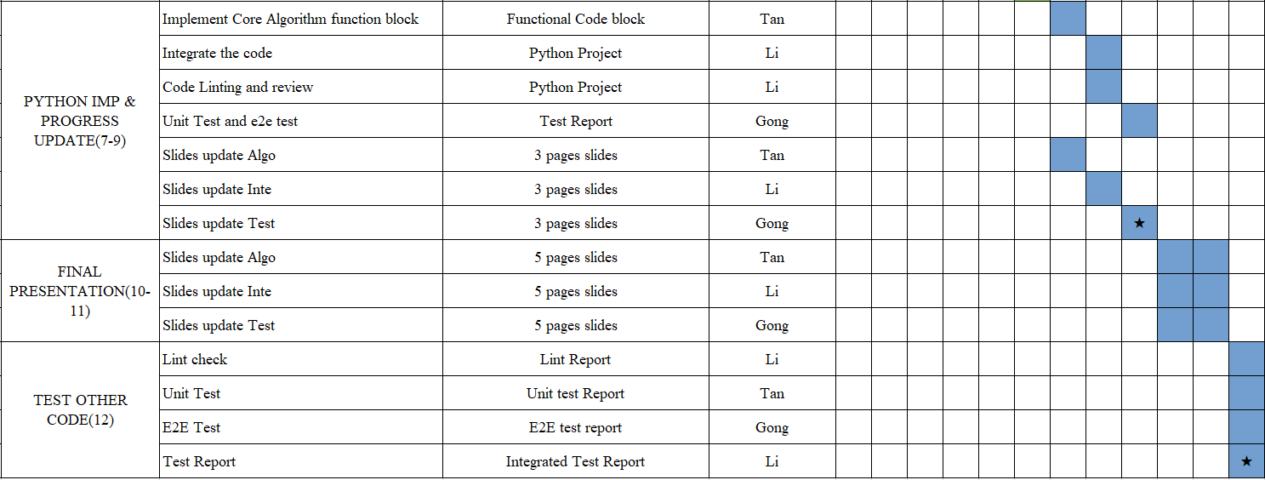
Milestones and timeline
Project implementation Gantt chart (week 9 – week 12)
Notes:
To build up these applications on time, we need a timeline and milestones.
We use Gantt plan to build up the timeline and mark the milestone of the project.
We split the tasks to small ones and mark the description…
With this Gantt chart, we can clearly find out what we need to do weekly and easily manage the project process.

Slide 3
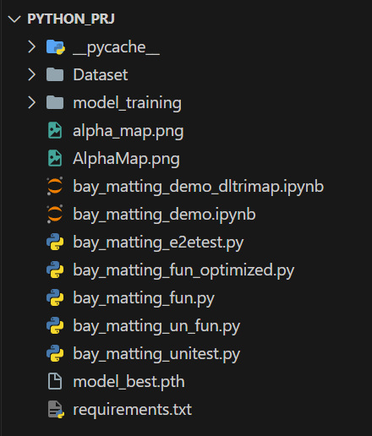
Milestones and timeline
We are here.
Successfully switch to Python code and successfully implement keying. (bay_matting_demo.ipynb)
Added basic test environment. (bay_matting_e2etest.py, bay_matting_unitest.py)
Add automatic Trimap generation using deep learning to increase automation and intelligence of the project. (bay_matting_demo_dltrimap.ipynb)
Overall code optimizations have been implemented to improve performance. (bay_matting_fun_optimized.py)

Slide 4
Thank You

